Slide 1
Logistic regression, SVM and RBF classification
Pouyan Seidiyan
Megh Kc

Slide 2
Analysis 1
Dataset
wine quality dataset from Kaggle
Target variable: wine quality (3-8 rank)
Classifier variables:
acidity parameters, PH, sulfates, sugar, chlorides & alcohol content
1599*12
Significance:
company can use this analysis to improve its wine products with the best quality, which affects market penetration

Slide 3
Analysis Techniques
Three level of wine quality quality
0- bad (3 & 4 -initial ranking)
1- medium (5 & 6 )
2- high (7 & 8)
One hot encoding for quality levels
Dataset split 80%, 20%
Logistic Regression
SVM (linear and polynomial classification)
RBF

Slide 4
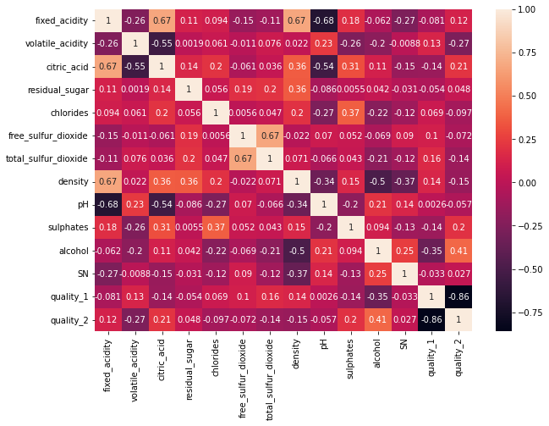
Results
Correlation between different variables

Slide 5
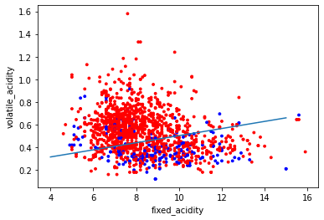
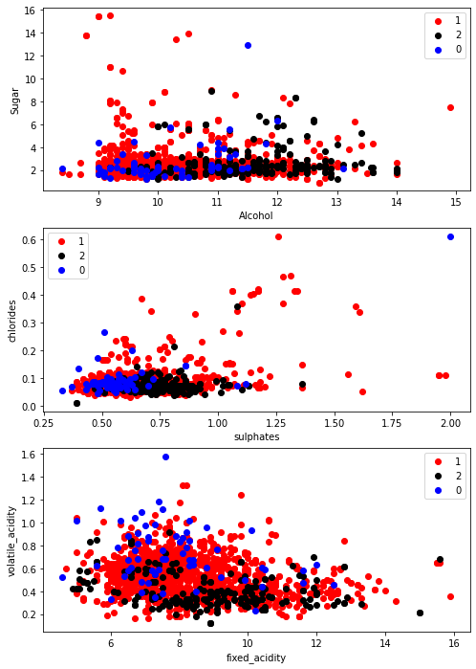
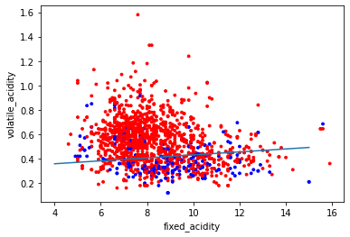
Results
Results
Logistic regression, weight 0.15
F-score [0.82,0.39]
Linear SVM, weight 0:1, 1:4
F-score [0.84,0.42]
Scatter plots for different independent variables

Slide 6
Results
SN | Analysis | f-score | remarks
1 | Logistic reg | [0.82,0.39] | weight 0.15
2 | Linear SVM | [0.84,0.42] | (0:1,1:4)
3 | Polynomial SVM | [0.90,0.16] | (0:1,1:4) deg-5
4 | RBF | [0.87,0.33] | (0:1,1:4)
SVM is good for this dataset
Polynomial kernel worked best
Class weight has changed the results
Model is seemed struggling to classify the positive values, could be because of the less data

Slide 7
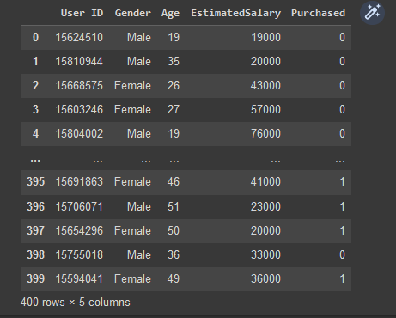
Analysis 2
Dataset
Social networking ads from Kaggle
Target variable: purchased
Classifier variables:
Age, gender, estimated salary

Slide 8
Analysis Techniques
Standardization
Dataset split 75%, 25%
Logistic Regression
SVM (linear and polynomial classification)
RBF

Slide 9
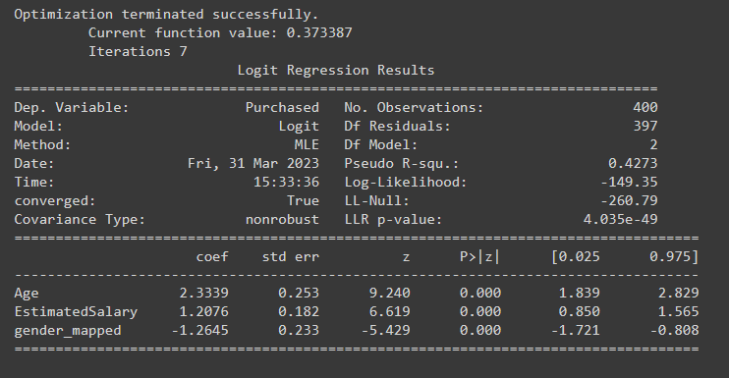
Logistic Regression

Slide 10
Results
SN | Analysis | Precision | Recall | f-score | Support | Remarks
1 | Logistic reg | [0.90,0.89] | [0.96,0.78] | [0.93,0.83] | [68,32] | w=0.4
2 | Linear SVM | [0.88,0.92] | [0.97,0.72] | [0.92,0.81] | [68,32]
3 | Polynomial SVM | [0.96,0.88] | [0.94,0.91] | [0.95,0.89] | [68,32]
4 | RBF | [0.83,0.85] | [0.93,0.67] | [0.88,0.75] | [68,32]
Logistic Regression and Radial Basis Function taking the least time
Conversely, SVM (Linear) took the longest

Slide 11
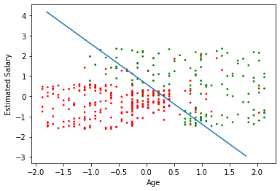
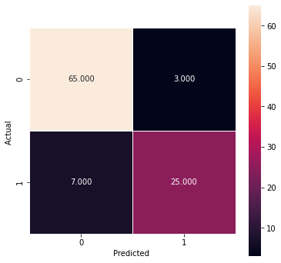
Green for purchase=1
Log Reg
Confusion matrix

